Slide 1
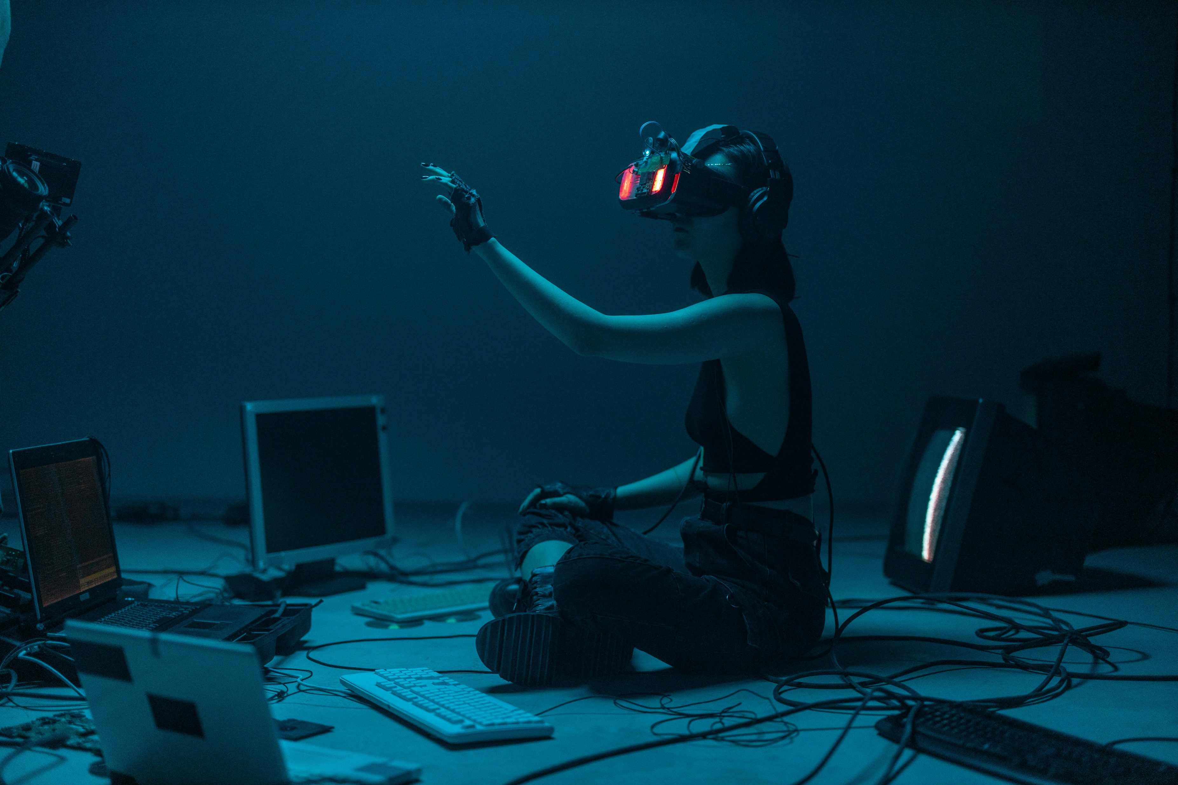
Artificial intelligence in daily life
bY:- kunal Varshney
25cabsa537
Bsc.(ca)

Slide 2
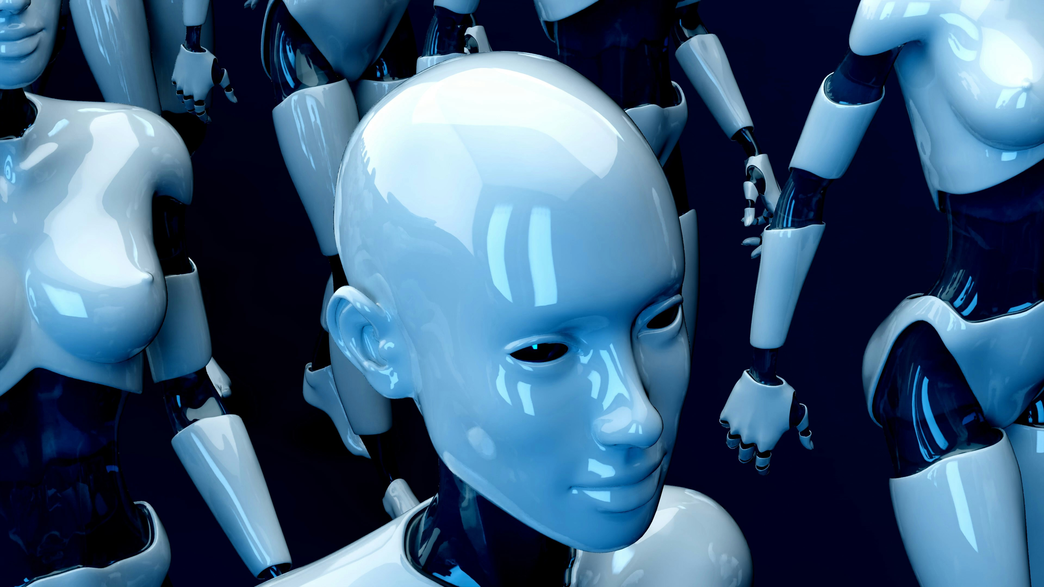
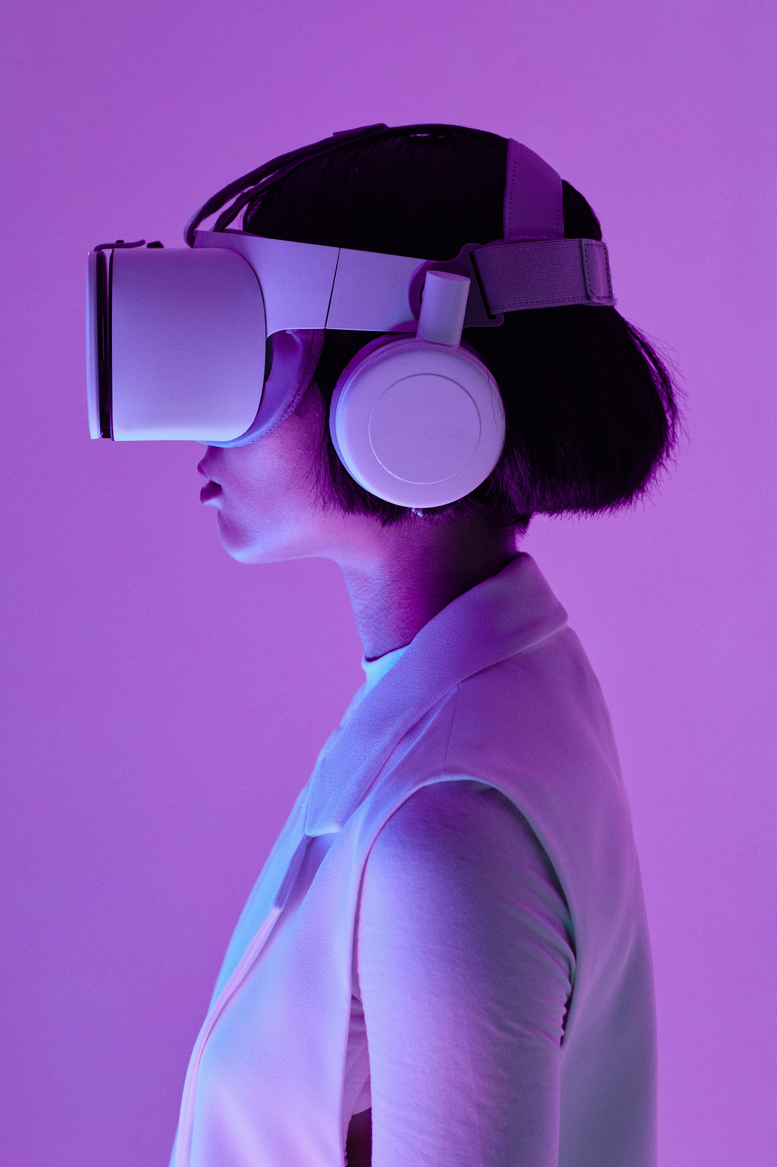
Introduction
What Is Artificial Intelligence(A.I)?
Machine simulating human intelligence.
AI systems can learn,reason,and make decisions.
Used in almost every field today.

Slide 3
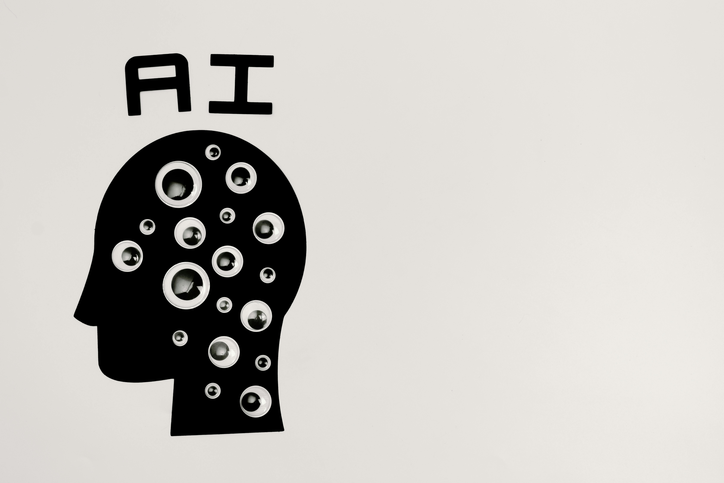
Application of A.i
HEALTHCARE:- Disease detection,surgeries,drug discovery.
EDUCATION:- Personalized learning apps,smart tutors.
TRANSPORTATION:- Self-driving cars,traffic management.
BUSINESS:- Chatbots,fraud detection,data analysis.
DAILY LIFE:- Voice assistants(Alexa,Siri),recommendations(Youtube,Netflix).

Slide 4
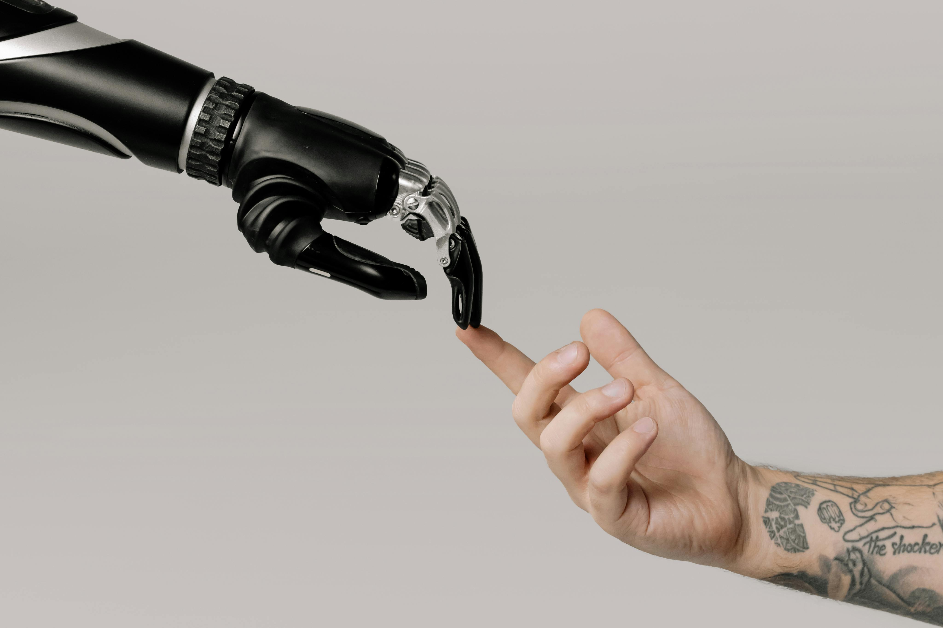
Advantages & challenges
ADVANTAGES:-
Reduces human efforts
Increases efficiency
Provide accurate results
CHALLENGES:-
Job replacement fears
High cost of development
Ethical concerns & data privacy

Slide 5
conclusion
AI is transforming the world rapidly
Brings both opportunities and challenges
Future depends on how responsibly we use AI
“AI won’t replace humans, but human with AI will replace humans without AI.”

